Slide 1
Collegiate Wind Competition ‘19 – Mechanical Design
4/26/19
Faisal Alrashidi
Naser Alrashidi
Tanner Lehr
Riley Sinek

Slide 2

Project Description
U.S. Department of Energy is the sponsor
Collegiate Wind Competition
Competition held in Boulder, Co. May 6th-9th
Sixth team representing NAU at the Competition
Collaboration with Electrical Engineers
1 of 12 Universities invited to competition
Faisal 1

Slide 3

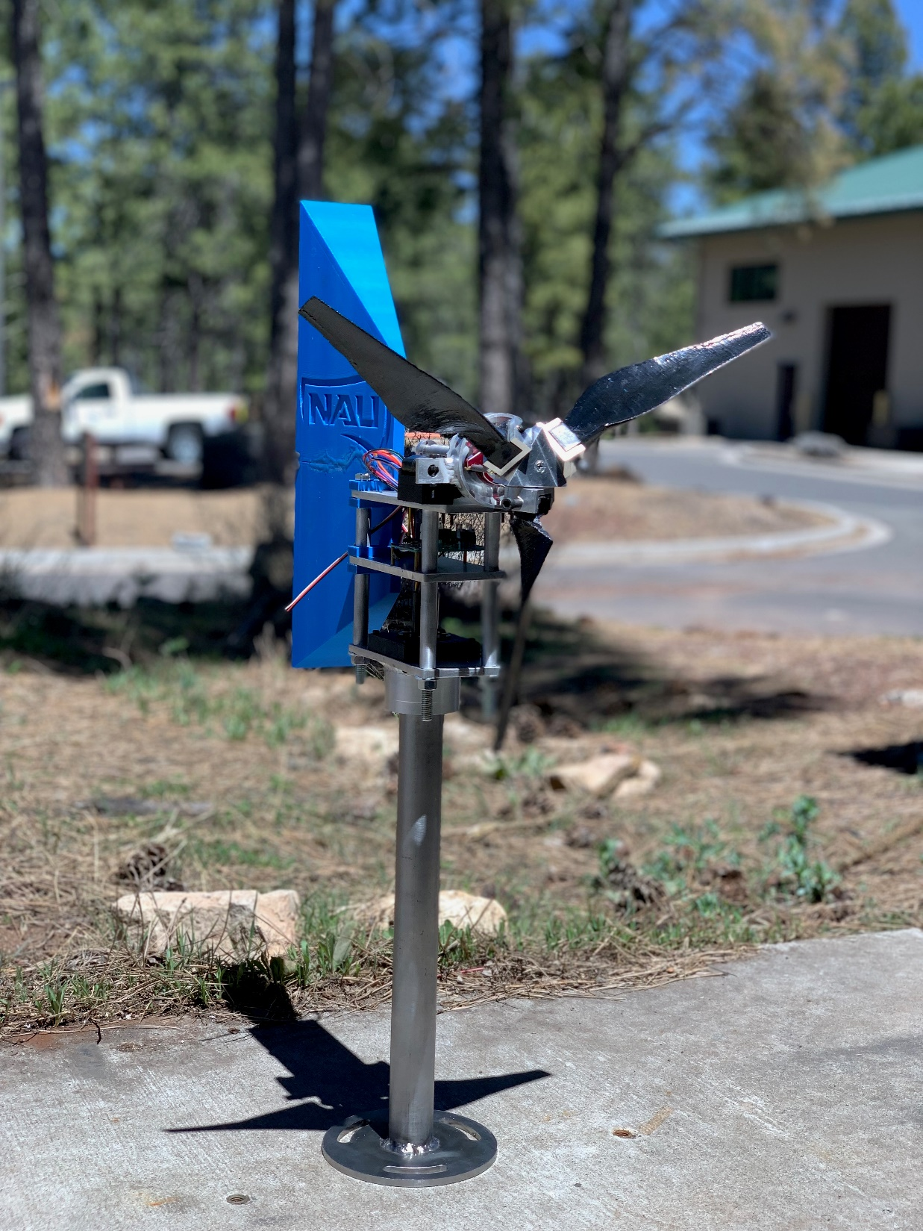
Project Description contd.
Tunnel Turbine
Cut-in task
Safety task
Durability task
Power curve task
Rated RPM and power control task
Faisal 2

Slide 4
Customer Requirements
Single Tail Yaw
Pitching Mechanism
Early Cut-in
Efficient Yawing
Reliable Braking System
Modular Design
Wind Tunnel Volume and Access Limits
Naser 3

Slide 5
Engineering Requirements
Cut-in between 2.5m/s and 5m/s
Yaw rate up to 180°/s
Reduce rotor speed to 10% of rated rpm within 10s
Must fit through 122cm by 62cm door
Turbine parts must stay with a 45x45x45 cm³ cube
Shaft height must be 60±3cm above base plate
Naser 4

Slide 6
Design Motivation
Blade | Yaw | Nacelle | Shaft | Brake | Tower
Carbon-fiber reinforced nylon filament | Pyramid-shape and size | 3 Levels Store ME and EE components | Two different diameters Two flat surfaces Attach to Generator | Linear actuator Brake caliper with mountain bike pads Bearing block holder for shaft | 1018 Steel 1.5” OD 1” ID
Naser 5

Slide 7
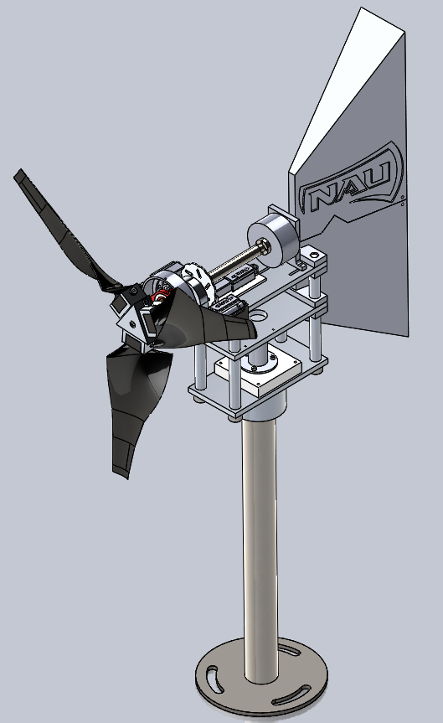
Final Design
Final model from SolidWorks
Naser 6

Slide 8
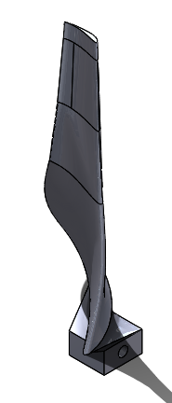
Final Design - Blades
Blades were designed using Blade Element Momentum theory
MATLAB was used to optimize the blade geometry
Increased chord length to achieve high rotor solidity
Riley 7

Slide 9
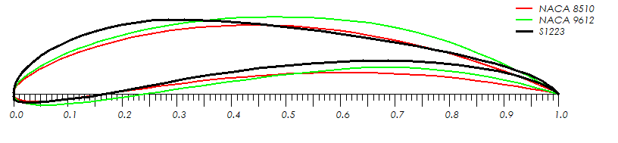
Airfoil Selection
Three airfoils were integrated into the blade design
High cambered airfoils were chosen based on the low Reynold’s Number Regime
Riley 8

Slide 10
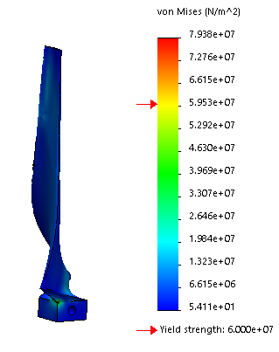
Blade Safety Analysis
FEA for the blade throws a minimum factor of safety of safety of 0.756
Caused by small stress concentration near blade root
Riley 9

Slide 11
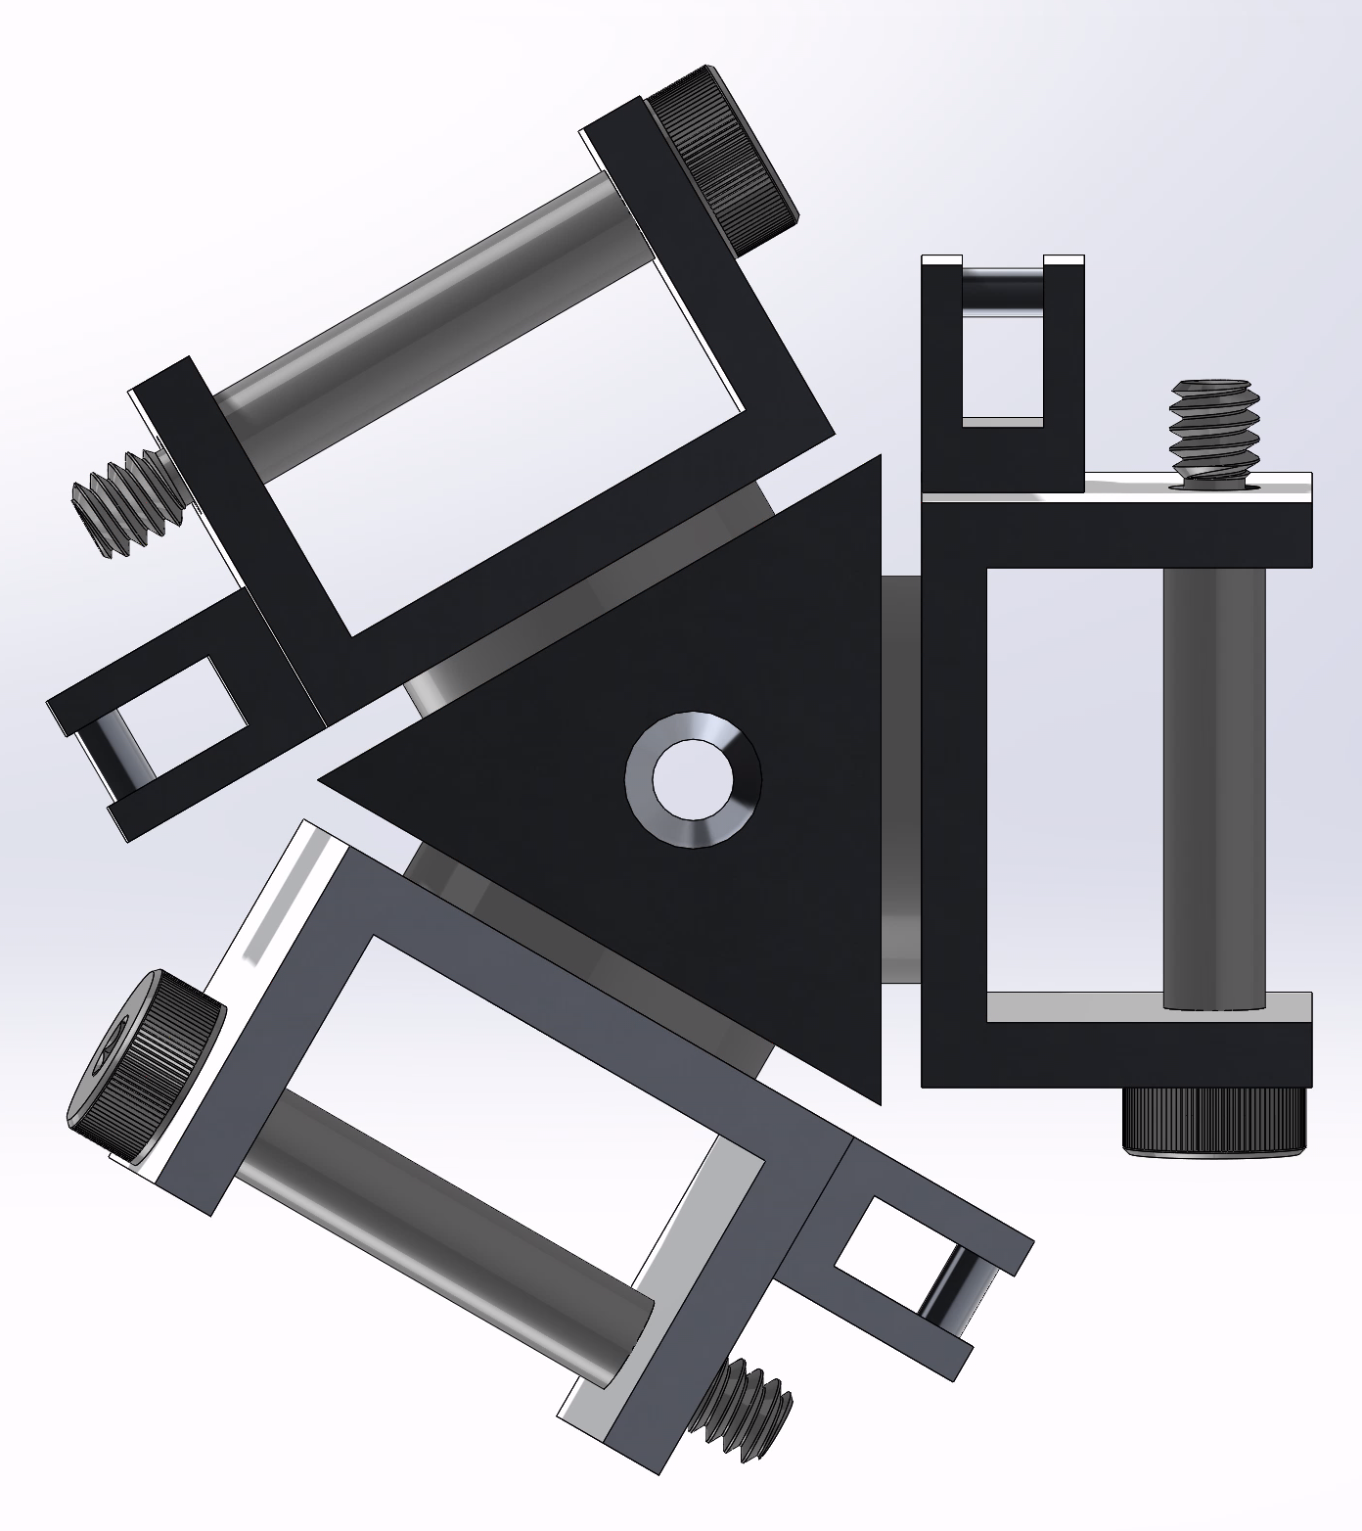
Final Design - Hub
Integrated a pitching mechanism for turbine
Six design iterations before beginning machining
Incorporated Triangular hub and “claws”
All components were manufactured in-house
Riley 10

Slide 12
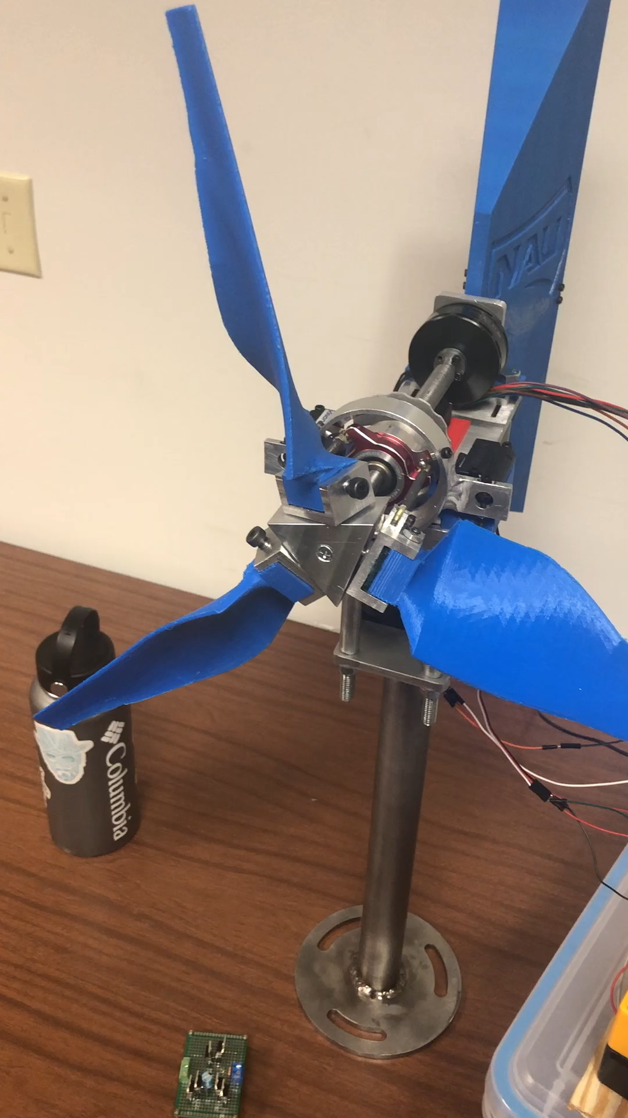
Active Pitching Mechanism
The mechanism was designed to achieve early start-up and avoid stall during operation
Mimicked helicopter mechanism to control attack angle of blades
Swashplate with two linear actuators to control blade pitch
Riley 11

Slide 13
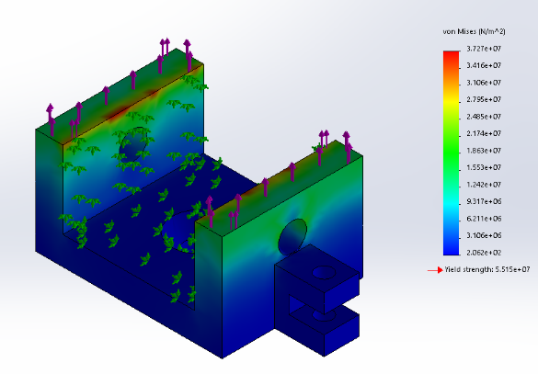
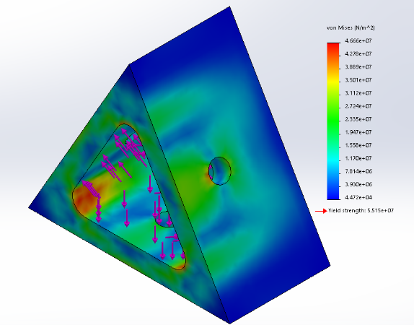
Force Analysis on the Hub
FEA showed safe results for confidence in final design:
Minimum F.S. for Hub: 1.18
Minimum F.S. for claws: 1.48
Riley 12

Slide 14
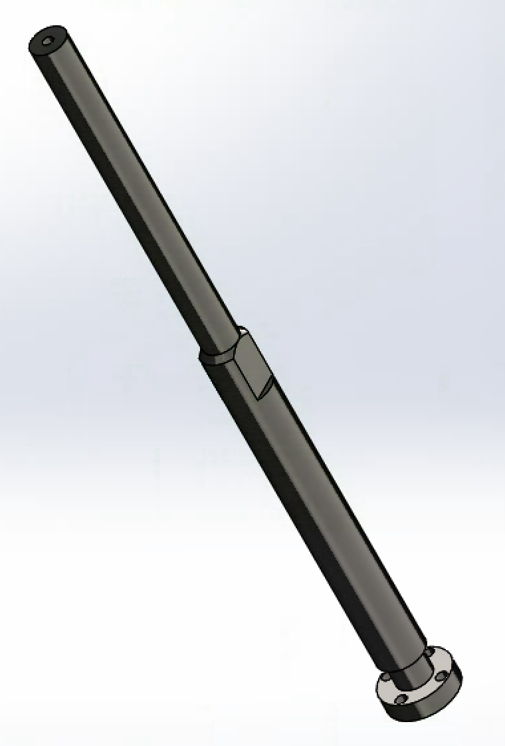
Final Design Shaft
Used two flat surfaces instead of keyway
Based on the individual analysis this was best
The material is 1018 steel
Manufacturing operations
Lathe
Mill
Tap
Factor of Safety for the design
2.2
Naser 13

Slide 15
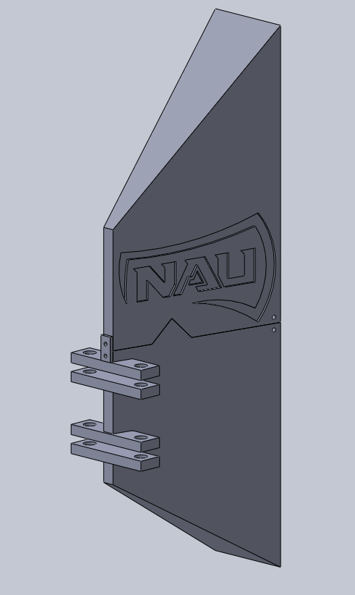
Final Design Yaw-tail
Maximized surface area
Center of gravity moved back further
3D printed with ABS plastic
Aluminum was harder to manufacture
The tail was printed in two pieces and epoxied together
Faisal 14

Slide 16
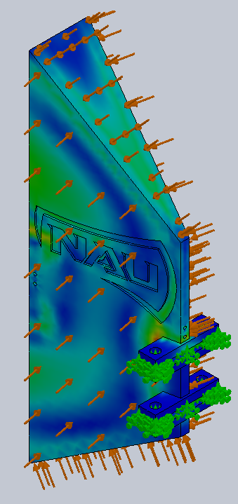
Tail-yaw FEA
Effective Drag Force on the tail
20N
Factor of Safety for the design
2.2
Faisal 15

Slide 17
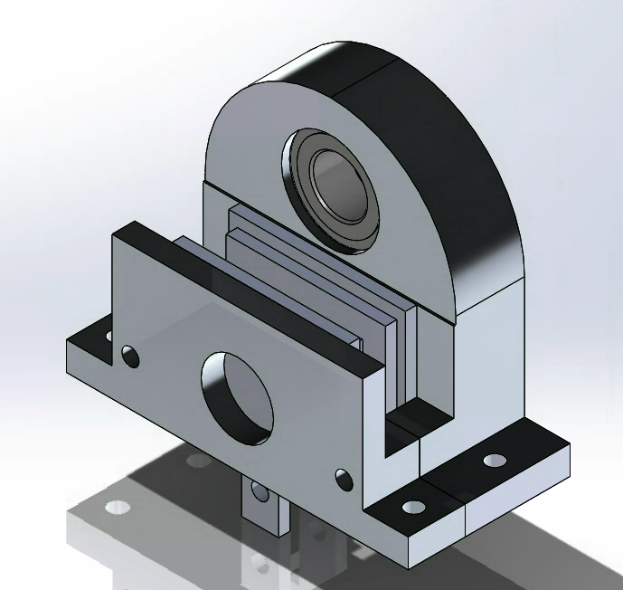
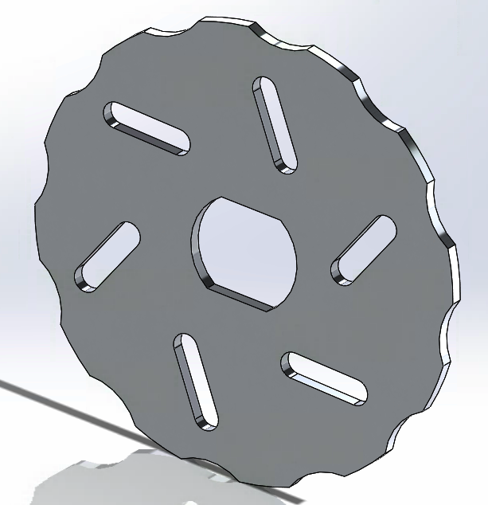
Final Brake Design
Designed brake caliper around a linear actuator
4 iterations were made
Incorporated bearing block into caliper
Brake pads are from a mountain bike
Designed rotor disc brake
Modeled after small scale RC car disc brakes
All pieces were CNC'd in house
Tanner 16

Slide 18
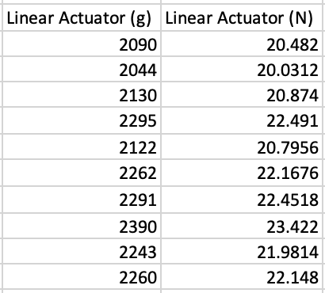
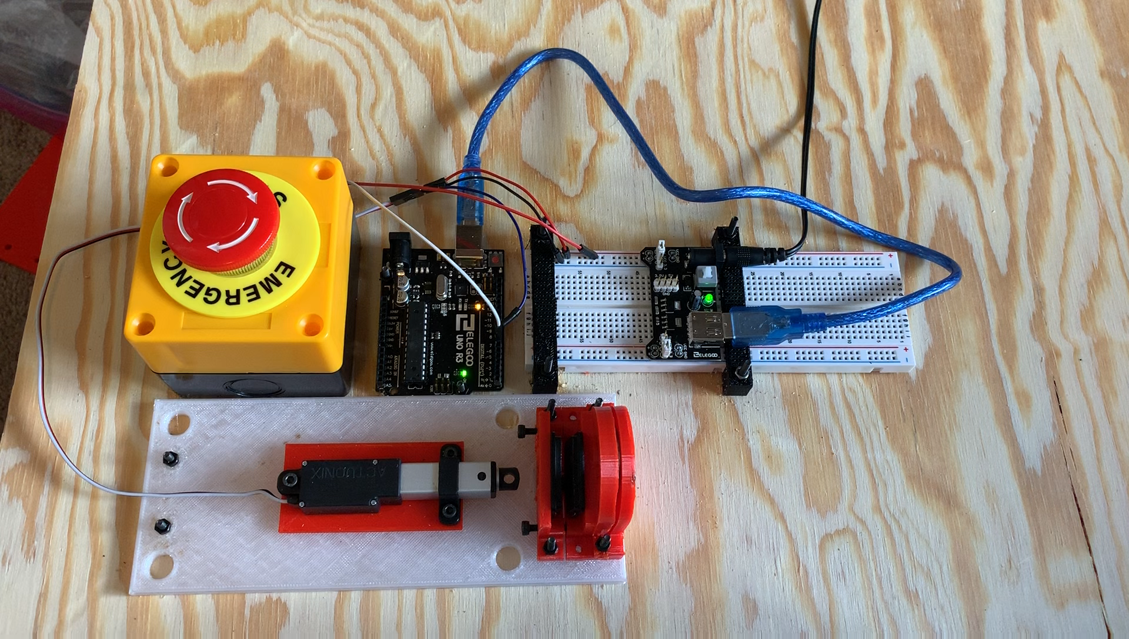
Brake Testing
Tested forces using kitchen scale
Scale was in grams --> converted to Newtons
10 tests showed an average of 21.68N
Actuator rated for 22N
Tanner 17

Slide 19
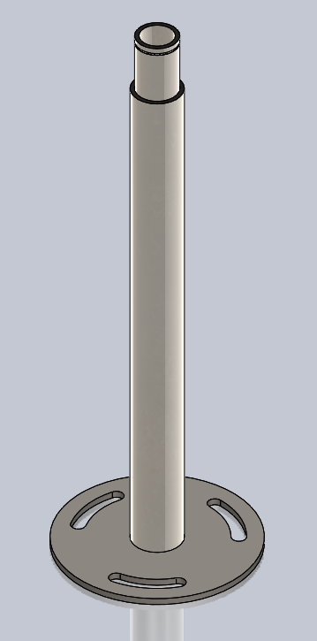
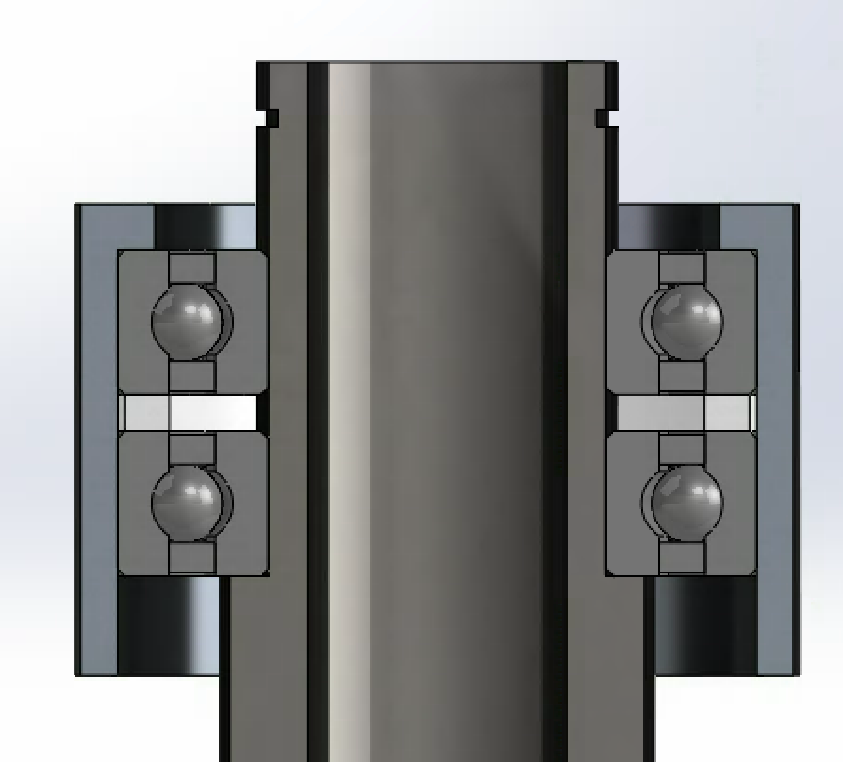
Final Designs Tower & Yaw Bearing
Tower
1018 Steel
Easy to machine
Tensile strength is 370 MPa
Welded base plate
1018 Steel
Yaw Bearing Assembly
Two deep grove ball bearings
Retaining Ring
Tanner 18

Slide 20
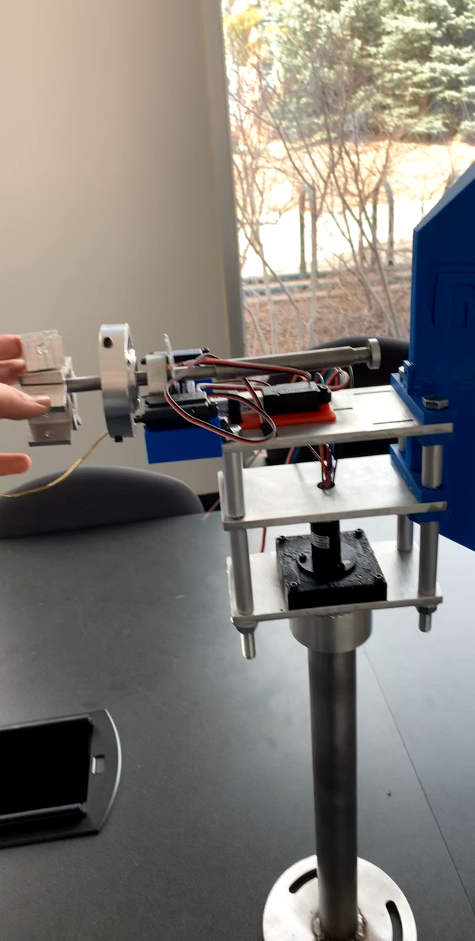
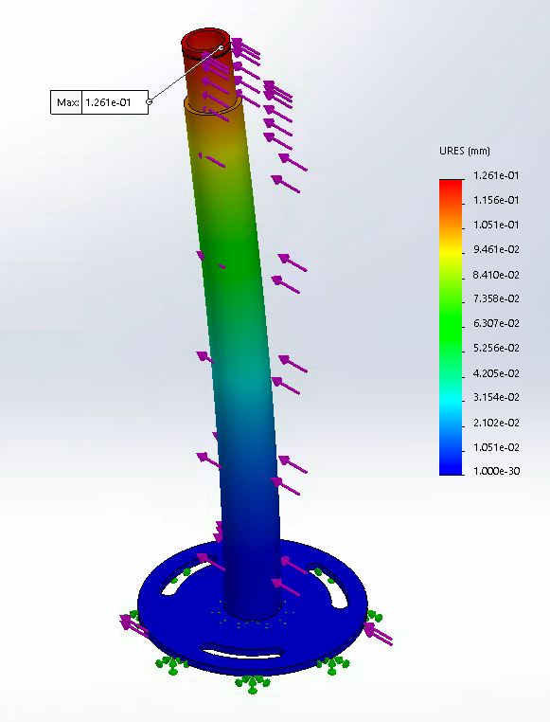
Tower FEA and Yaw Bearing Testing
Yaw Bearings
Deep Grove Ball Bearings rated for 15,000 rpm
SolidWorks FEA
Max deflection: 0.126 mm
Minimum Factor of Safety: 45.58
Tanner 19

Slide 21
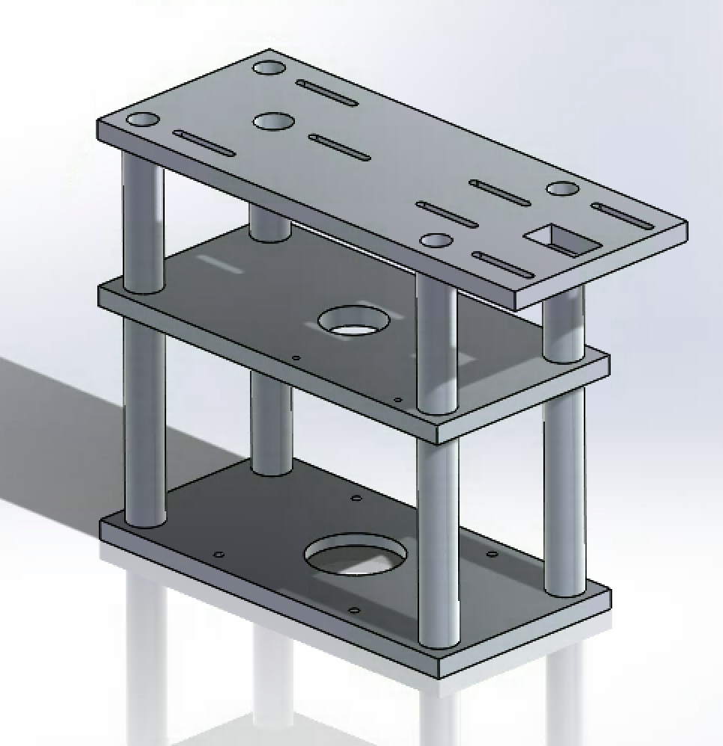
Final Design Nacelle
6061 Aluminum
3 "Levels"
Top: brakes, shaft, and generator
Middle: rectifier
Bottom: slip ring
Slots added so placement of everything can be changed as needed
Tanner 20

Slide 22
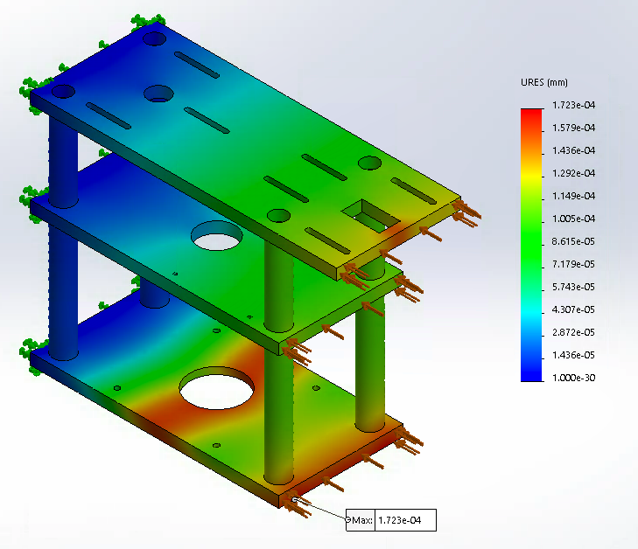
Nacelle FEA
Factor of Safety: 180.2
Max Deflection: 1.72*10⁻⁴ mm
Tanner 21

Slide 23
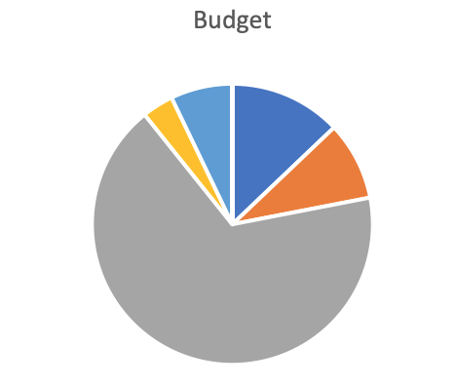
Budget
Miscellaneous
Building Materials
Epoxy and Glue
Blade Material
Actuators, motors, and Arduino: $1081.96
Building Materials: $207.28
Blade Material: $145.61
Epoxy and Glue: $58.15
Miscellaneous: $114.56
Total: $1753.02
Actuators, Motor, & Arduino
Tanner 22

Slide 24
Thank you to...
W.L. Gore and Associates
The U.S. Department of Energy
David Willy
Dr. Oman
Amy Swartz
Riley 23

Slide 25
Questions?

